Slide 1
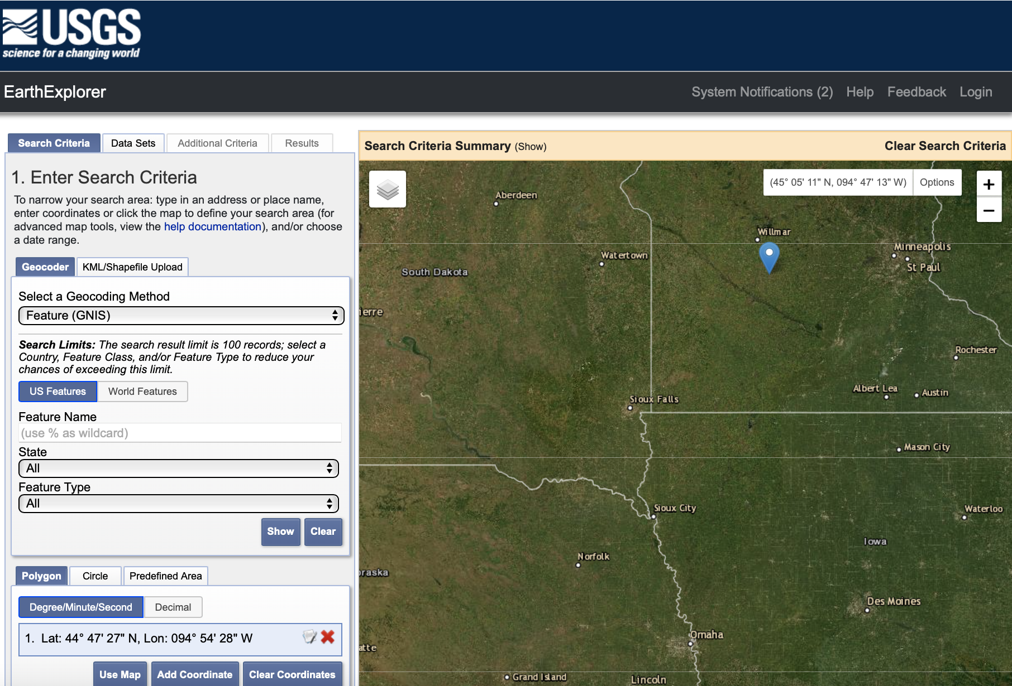
Step 1

Slide 2
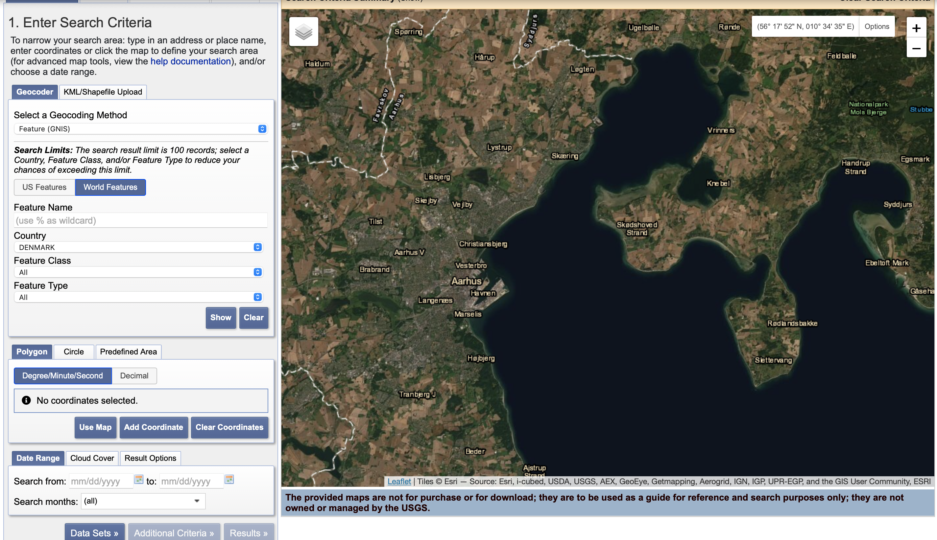
Step 2a select the World Features
Step 2b select Denmark
Step 3a Polygon tool
Step 3b Use map

Slide 3
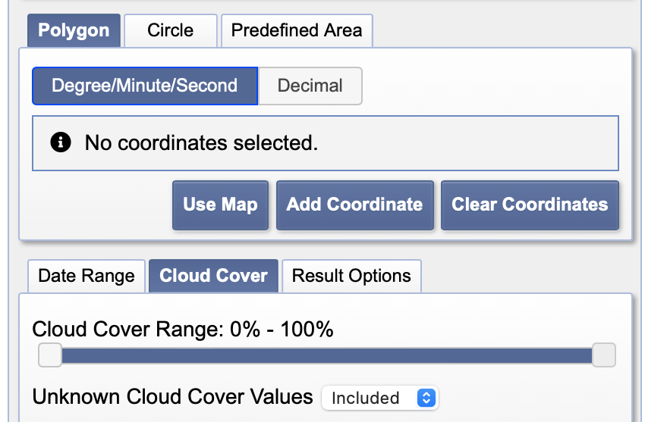
Step 4 Define the date range
Step 5 Define the cloud Coverage

Slide 4
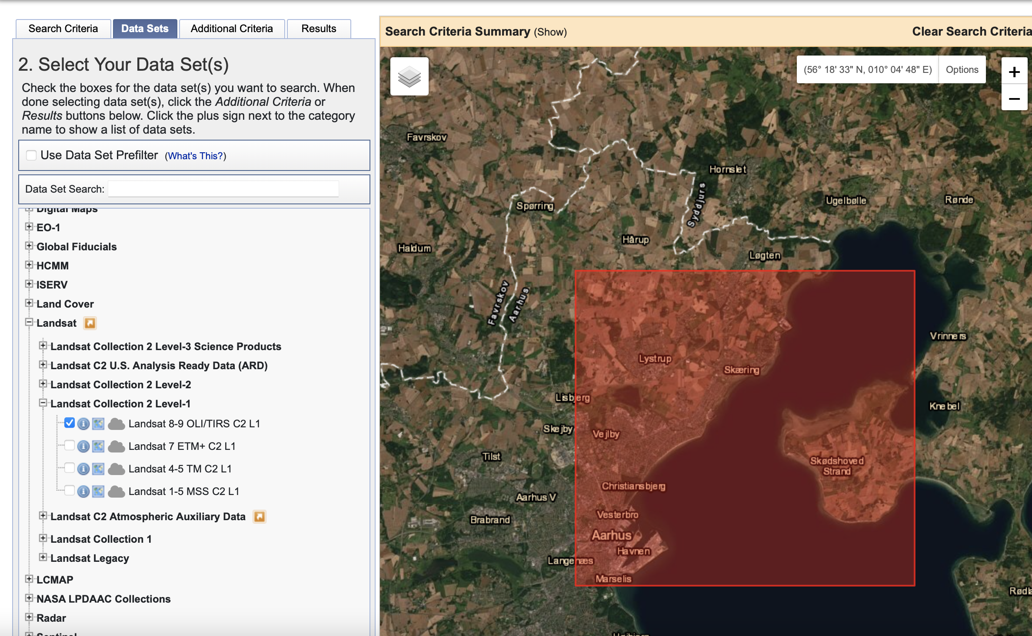
Step 6 Select the Landsat Collection 2 Level 1
Step 7 Select the Landsat 8 data

Slide 5
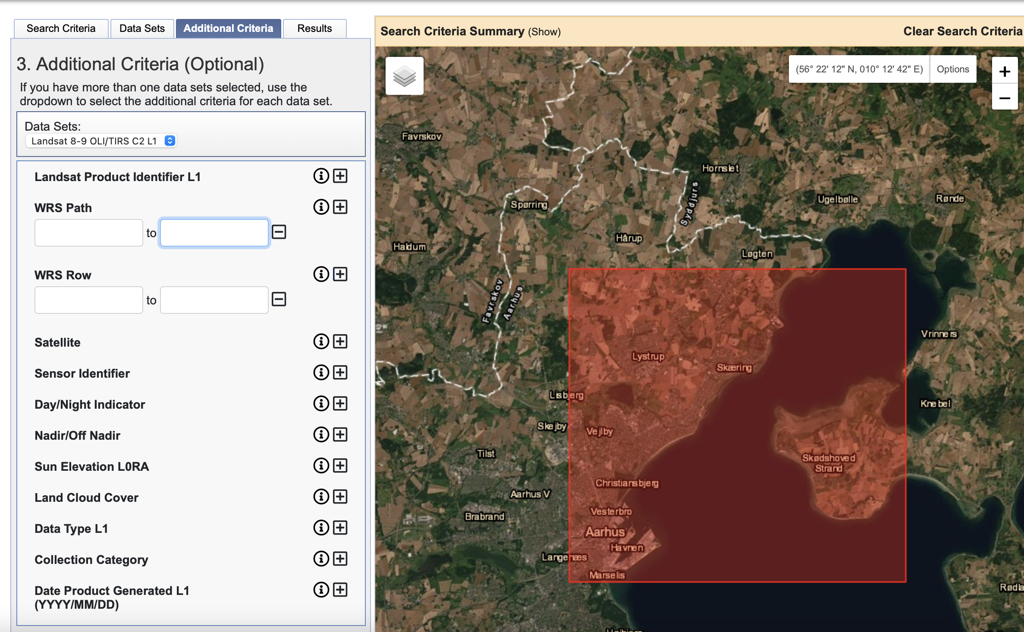
Step 8a Define the Path
Step 8b Define the Row

Slide 6
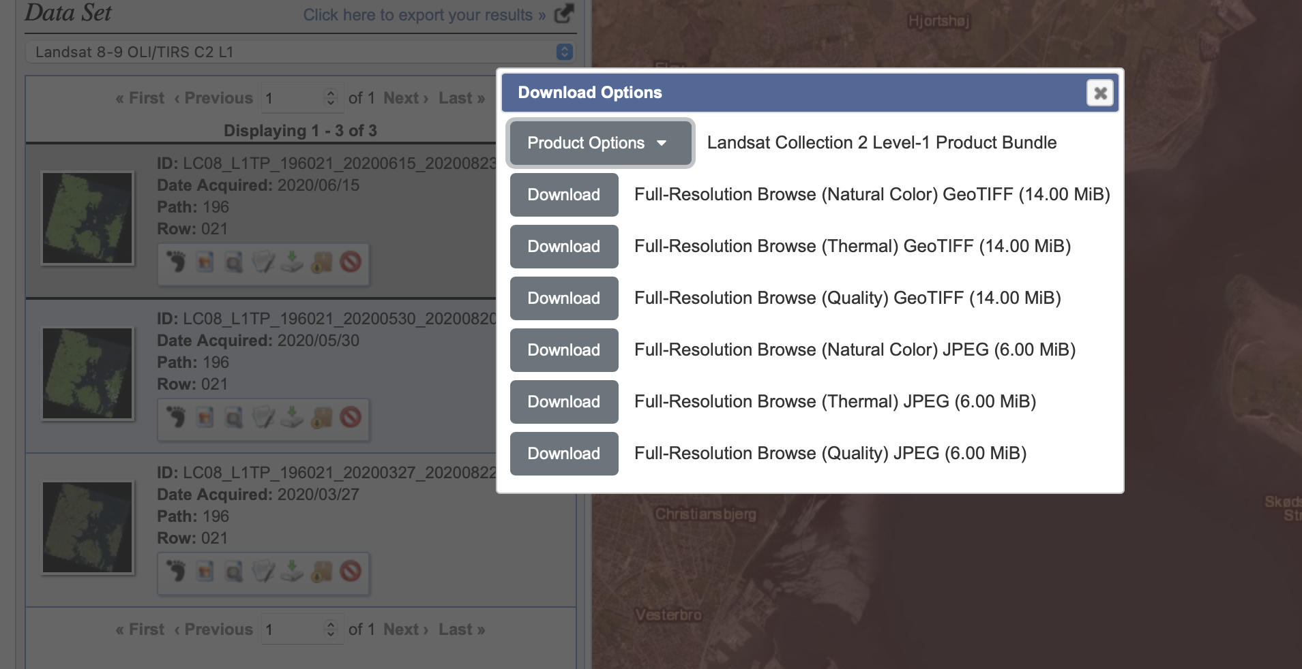
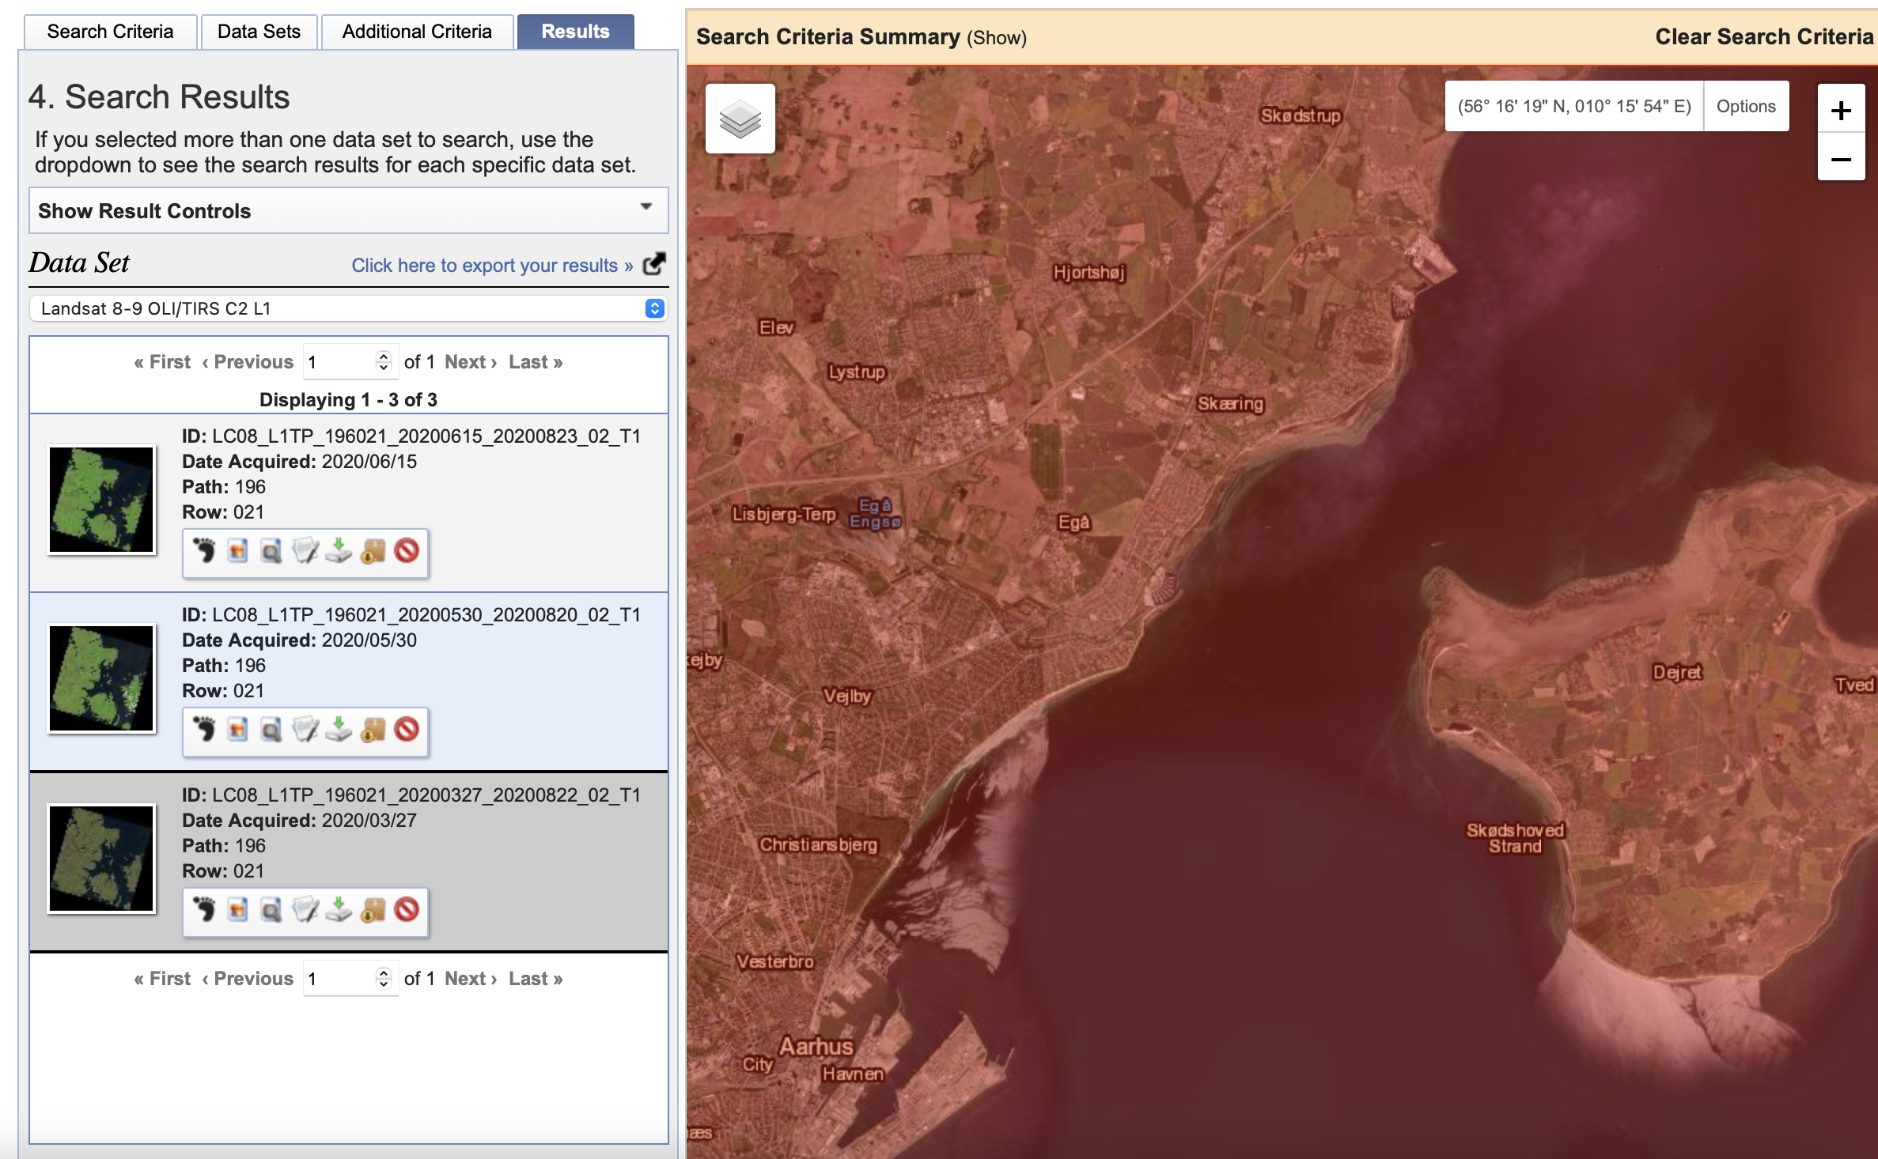
Setp 10 get the Landsat Collection 2 Level-1 Product Bundle
Step 9 Search for the right image and download it

